Slide 1
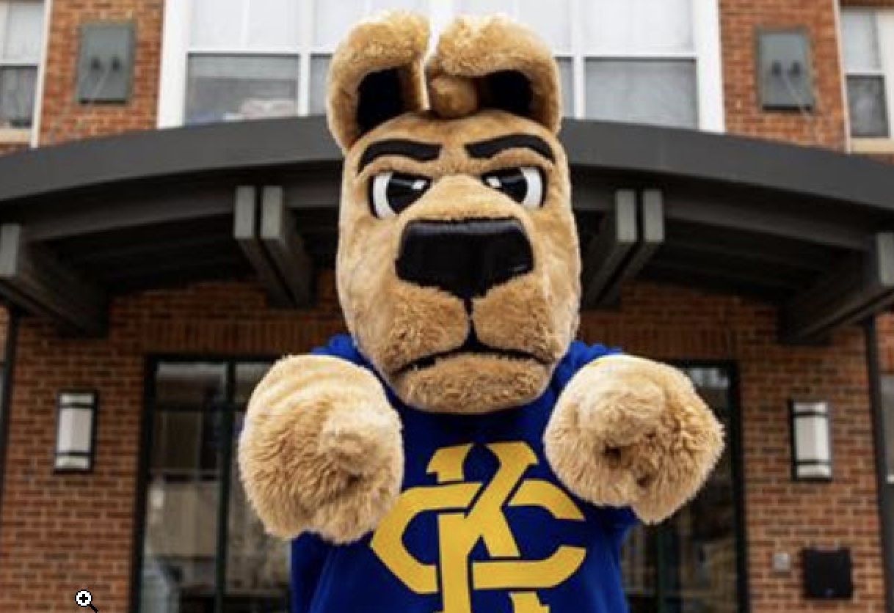
Division of Student Success: Collaborating with Faculty Kristi Holsinger, Ph.D. Senior Vice Provost for Student Success

Slide 2
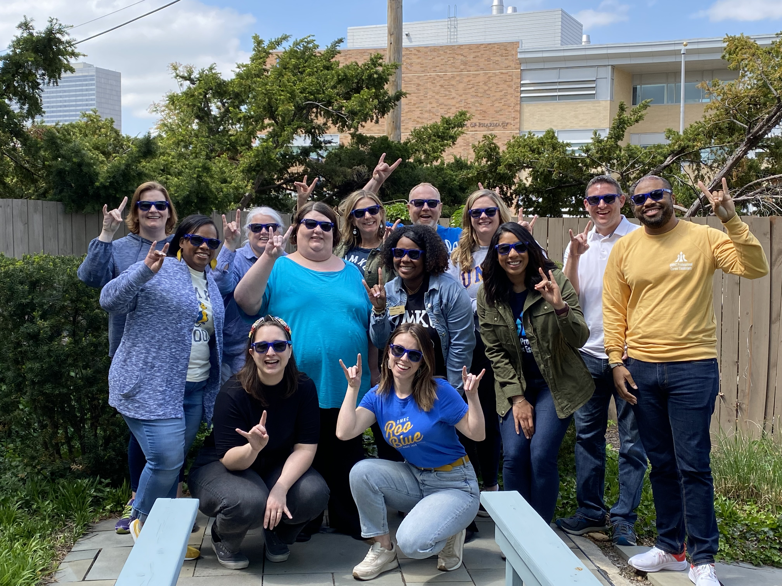
Division of Student Success
Enrollment Management: Admissions, Financial Aid, Registrar, UMKC Central, UMKC Connect
Roo Advising (Academic Undergraduate Advising)
Academic Support and Mentoring (Supplemental Instruction, Tutoring, Writing Studio, Summer Bridge, First Gen Roo Scholars)
Career Services
Professional Career Escalators
KC Scholars (n=543) and Bloch Scholars (n=143)

Slide 3
Doug Swink Assistant Vice Provost of Enrollment Management
Elora Thomas Director of Admissions
Scott Young Director of Financial Aid and Scholarships
Amy Cole
Director of Registrar’s Office
Amber Daugherty
Director of UMKC Central
Michelle Pellegrino
Student Retention Technology Specialist/Starfish Administrator
Tammy Welchert Director of Roo Advising
Jessica Brooks Director of Academic Support and Mentoring (ASM)
Davlon Miller Director of Career Services
Mako Miller Director of Professional Career Escalators Program
N’ninah Freelon
Director of KC Scholars Program
Marge Wight
Director of Bloch Scholars Program

Slide 4
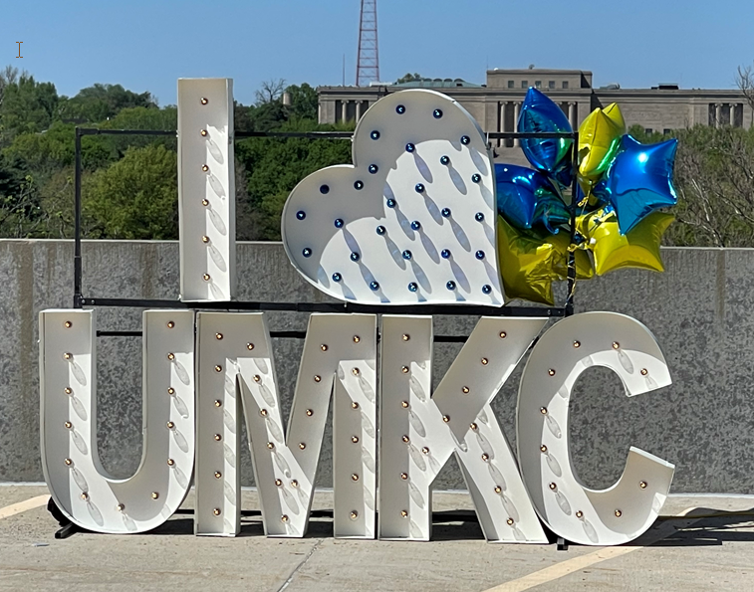
STAT: Student Success Action Team
A cross-campus collaboration to improve the rates at which we enroll, retain, and graduate underrepresented students (race/ethnicity, gender, Pell status, first gen)
Address achievement gaps and improve student success metrics
Supports Pillars 1 and 4 of UMKC’s Strategic Plan
…a key duty of the university should be to ensure that
students who arrive at college with fewer educational,
social, or financial resources are equipped to succeed
at the same rate as their peers
(https://wac.colostate.edu/docs/books/boyer2030/report.pdf)

Slide 5
STAT: Fall 2020-May 2022
Post Secondary Equity Network (PEN, now part of MOCAN): Nov. 2019, over 20 MO colleges and universities advancing equity-minded strategies, supports institutional equity plans, build DEI leadership capacity of higher ed professionals, support alignment between college and career
UMKC Student Affairs Student Listening Sessions: Summer 2020, guided work addressing student social, academic, and financial challenges
Subcommittees: Recruitment/Affordability, Sense of Belonging, Faculty Engagement, Staff/Advising
Initiatives: Financial Wellness Center, Center for Transfer Students and Adult Learners, Food Insecurity/Basic Needs, Micro grants for near completers, Roo Connection (student newsletter), First Gen Roo Scholars expansion, Early College Academy/KCPS and NKC Partnerships, Roo Advising (trainings, Getting to Know You appts., Inclusive Advising, targeted outreach), Men of Color Academy
Two MSLF Grants: Equity Minded Workshops, Minority Male Initiatives, Faculty Inclusive Curricula Program, Early Career Summit, Adult Learner Student Stipends, Professional Career Escalators

Slide 6
STAT 2.0: Fall 2022-Present
Initiatives:
Retention program coordination and outreach
Implementation of Starfish Analytics
Discussions on how we will use Analytics and planning for targeted outreach
Faculty engagement (use of Canvas, gradebook, UMKC Connect flags and kudos)
Exploring Graduation Help Desk with near completion grants (expansion of micro grants)
Implemented new scholarship reinstatement policy
Pilots on support for provisional admits and students on academic recovery
Added Campus ESP for current students’ families/supporters
Childcare survey, exploring funding for childcare grants
Student satisfaction surveys in Roo Advising

Slide 7
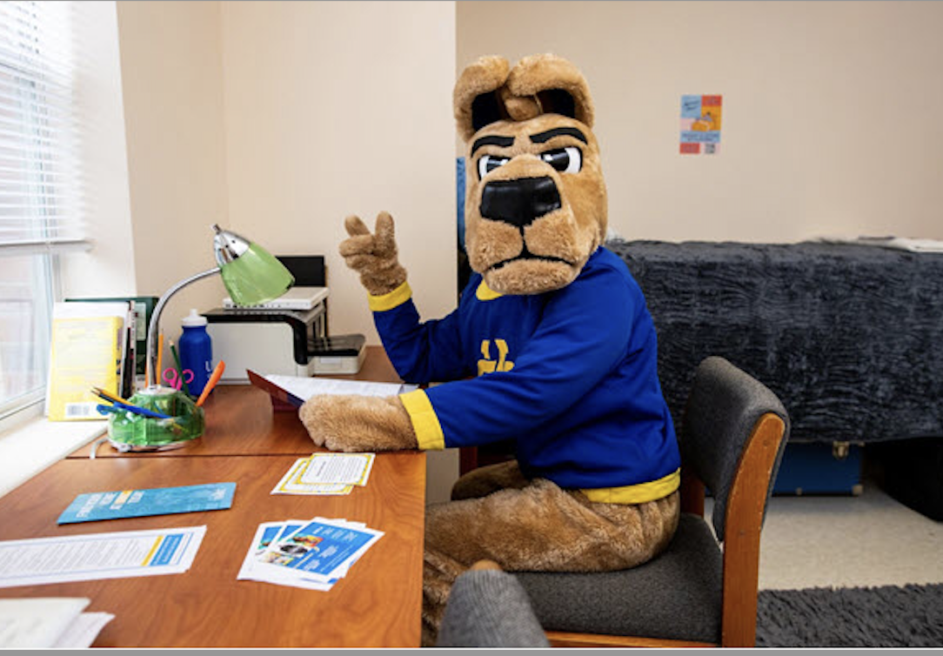
NISS
Partnership with the National Institute of Student Success at Georgia State
Systematically redesigning student services to improve student outcomes
Identify and resolve institutional barriers (policies and practices) to equity and college completion
Diagnostic process to identify our strengths and existing challenges that hinder student success
A “playbook” detailing recommendations and specific steps to address barriers to completion
Implementation beginning this summer with goal of creating equitable student success outcomes
Four areas of focus: Data, Student Communication, Career Services, Program Curriculum/Courses (Degree maps, DFW rates, Academic advising, Course offerings)

Slide 8
Student Success at UMKC
Culture of care, meet students where they are, foster growth mindset and culture of learning
Holistically address all barriers to student success, including non-academic factors
Promote culture where students actively seek help, share challenges
User-centered, case management approach, more like health-care systems, refer to expert
Working toward physical centralization of student services to increase visibility and accessibility

Slide 9
Faculty Supporting Student Success
Onboarding Students to the Purpose/Mission of Higher Ed
Learning, transforming one’s mind, long term benefits
Improve Faculty Knowledge of and Referrals to Campus Student Support Services
Create and Communicate Plan for Struggling Students
Provide many opportunities for assessment of learning and feedback
Use Campus Tools
Canvas, Gradebook, UMKC Connect, Act on high DFW courses
Focus on Preparing Students for Careers/Professions
Career embedded in courses/degree programs, building networks, developing robust resumes through campus involvement

