Slide 1
UMKC IS ADVISORY COUNCIL
Thursday, October 17th, 2024

Slide 2
WELCOME

Slide 3
Courtesy Accounts & Email
Updates
Starting in FY25 all Courtesy accounts that have email will need a Microsoft A3 license.
Moving from needing an A5 licenses to an A3 license has brought significant cost savings.
Webpage updated with details of Courtesy / Volunteer accounts and what each can access
https://umkc.edu/is/resources/courtesy-appointments.html
Cleanup Process
Continued effort with HR and individual departments to clean up accounts on a 1-1 basis
Cleanup options include
Deleting courtesy account
Updating courtesy account to no longer have email, will continue to have access to other UMKC resources (computers, printers, shared files) – Job Code 9996
Keep the courtesy account with email – Job Code 9993

Slide 4
Software Update – Process / Grammarly
Software and Hardware Request Process
New software and hardware request forms created (ithelp.umkc.edu -> Get Started -> IT Procurement)
Service - Purchase Software (umsystem.edu)
Service - Purchase Hardware (umsystem.edu)
Replaces umkc-software@umkc.edu & umkc-hardware@umkc.edu as preferred method for new requests.
Unauthorized Software
Published list of unauthorized software, which have significant security concerns or existing standards.
https://www.umkc.edu/is/resources/software.html
Grammarly
Significant security concerns required restricting existing licenses to DCL1 data only as a stopgap.
Moving to a UM System-wide Education license
Overcomes security concerns
Lower price point - $50/year/user
Expect more about license migration in the next couple weeks

Slide 5
Software Updates – AI
Zoom AI / Teams Premium
Supported Meeting Assistants
Leverage AI to take notes, summaries, and action items
Replaces other meeting assistants, such as Otter.ai
Zoom AI, free for all standard Zoom accounts (not included in UM Protected Zoom)
Teams Premium, $22/year/user @ https://isssweb.umkc.edu/forms/microsoft/
Microsoft Copilot for M365
Pilot currently in progress with IS and HR
Cost is $350/year/user
Contact umkc-software@umkc.edu if interested in joining pilot
ChatGPT
Currently have about 60 faculty/staff using in various capacity
Working to get Education licensing (volume or campus) pricing now
Contact umkc-software@umkc.edu if any questions
Security approves based on each use case for specific DCL levels

Slide 6
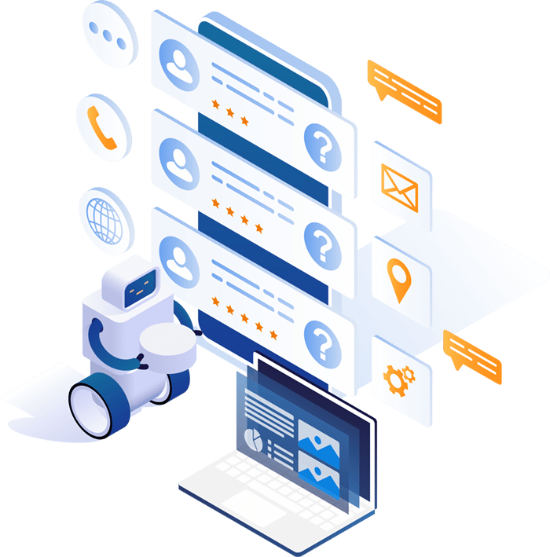
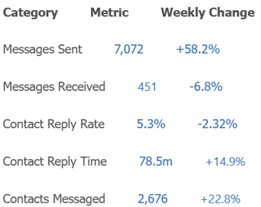
Software Updates - Texting
Cadence Mongoose
Campus wide solution that provides unlimited texting for any department on campus
IT funded solution
Currently looking at options to expand use with WhatsApp
Considerable usage across campus, last week for example

Slide 7
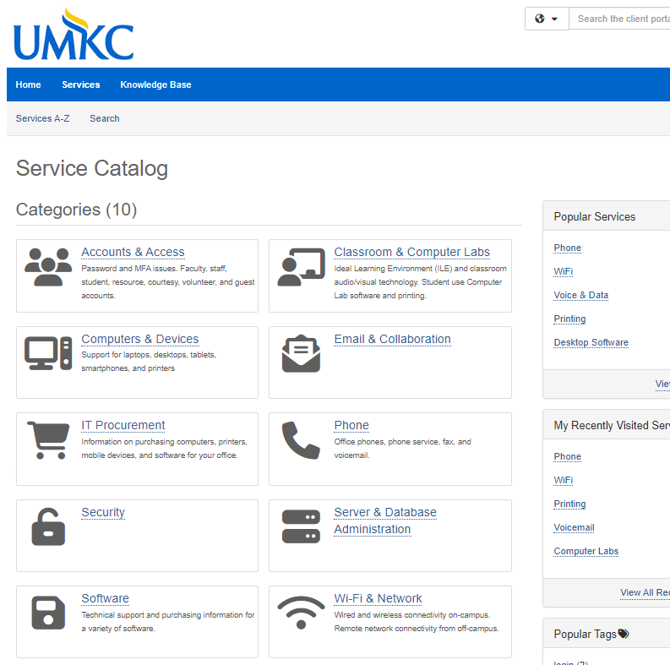
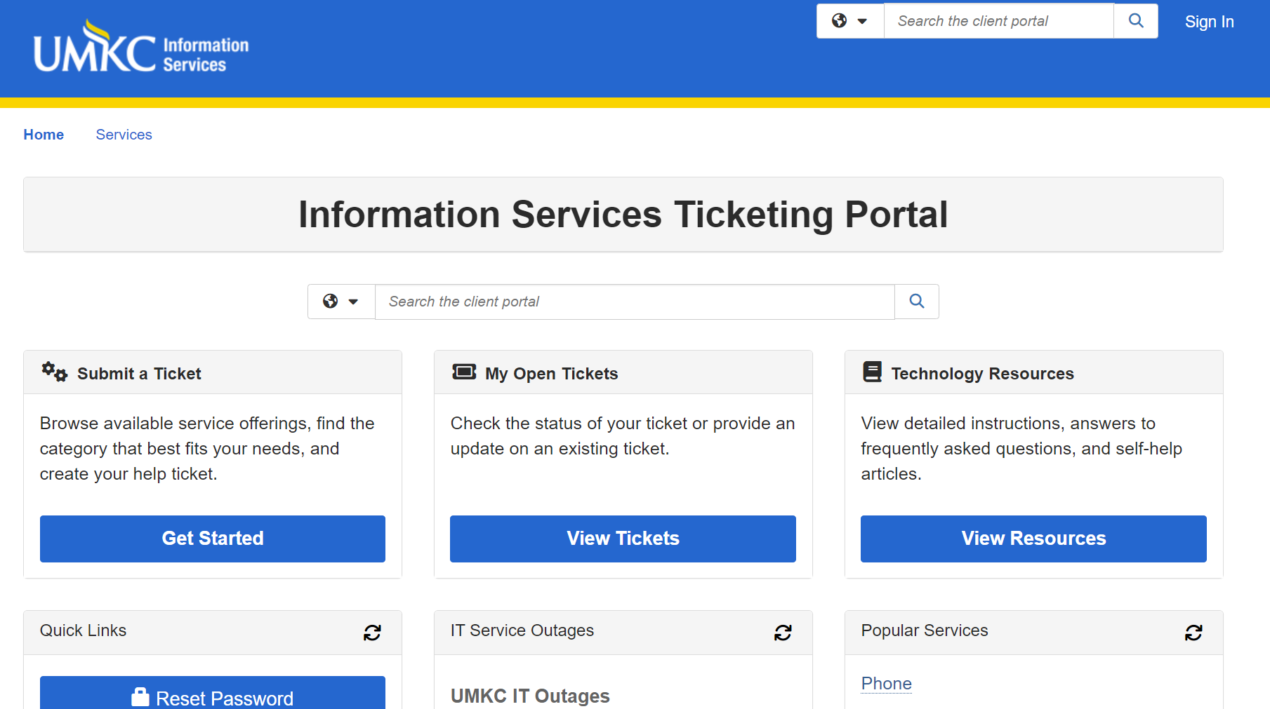
Ticketing (Team Dynamics) Updates
Ticketing System
UMKC launched TDX in August
Large project that’s been in flight since December
Initial feedback very positive
Continued refinements as we gather feedback
Conversational AI and Live Chat coming for Spring semester

Slide 8
Kuali Build
Kuali Build
Designed for Higher Education
Our online form and workflow builder has graduated from its implementation phase and pilot program. It is available to the campus at large.
We now have close to 40 applications in the system.
Approximately 2,000 forms have been processed to date.
Stricter ADA guidelines have been announced. This tool will help to replace inaccessible PDF forms found on our website.
Units needing several apps can now request access to build their own.
Those needing very few (or with limited resources) can request custom built apps from IS.
We love to meet with units to demo the software!
For more information, or to request a demo or access, please visit https://www.umkc.edu/is/resources/kuai-build.html

Slide 9
Information Access / Data Warehouse Updates
University Analytics & Institutional Effectiveness Collaboration
DSAS Services: Reporting & Data Requests, Data Warehouse, and Student Success
IA team working closely with Melvin Tanner, Director
Melvin’s team to take over Ad Hoc and Cognos reporting entirely
Reminder: No new reports in Cognos – maintenance only
Working together to migrate Cognos Reports to new solutions
Power BI reports/dashboards will continue to be done in collaboration
Data Warehouse
Old Server: Contacting last few people now and will shut down next week
Implementing a new technology platform from Microsoft called Fabric.

Slide 10
File Storage Recommendations
Local storage – N and Q Drives
Hard to use off campus and on mobile
Requires VPN from off campus
Limited space, Q drive quota is 500MB
N drive quota varies by unit
https://umkc.edu/is/resources/storage-hosting.html
Box
Easy access off campus and via Web
Best for sharing with external users
Only used at UMKC Faculty/staff, limited cross-campus collaboration
https://umkc.edu/is/resources/box/index.html
Microsoft OneDrive
Included as part of Microsoft 365
Integration with Windows and Office – real time file collaboration
Ability to backup Desktop, Documents, Pictures folders
Easy access off campus
Great for internal sharing and collaboration
1TB quota per user
https://umkc.edu/is/resources/microsoft_365/onedrive.html
Microsoft Teams
Best for shared storage, such as departmental files
5TB quota per Team
Includes Chat for members of the Team
Private channels to limit access to files as needed
https://www.umsystem.edu/ums/is/teams
Recommendation
Personal work files: OneDrive or Box
Shared departmental files: Teams
External sharing: Box
Most important, use one of the above options, not your local hard drive!
Contact the Tech Support Center for help!

Slide 11
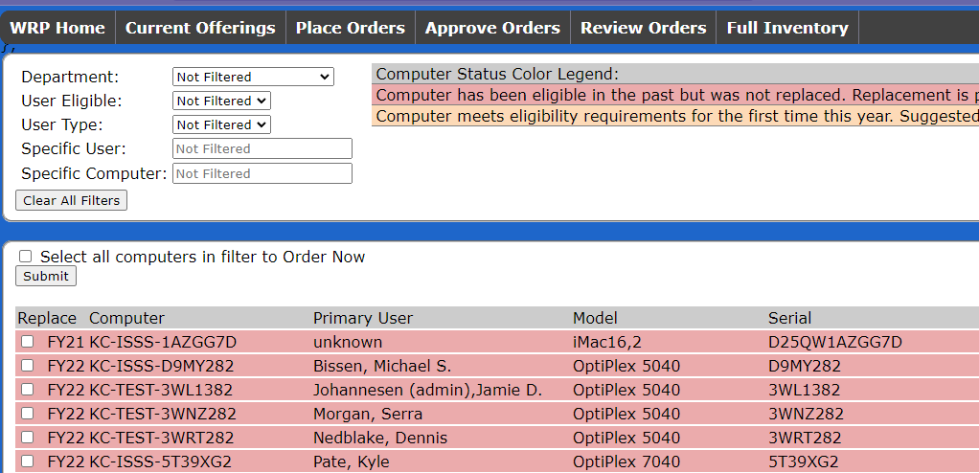
Workstation Replacement Program
Workstation Replacement Program
$1,500 stipend to be provided by Campus Leadership
Will cover 1 primary computer replacement for Faculty/Staff every 4/5 years.
Funding is not available for Research WRP currently
Timeline
Program to start and run through November
Emails will be sent to Advisory Council, Liaisons, and WRP contacts with more details in early November
Full details will be available at wrp.umkc.edu
Available now to review early

Slide 12
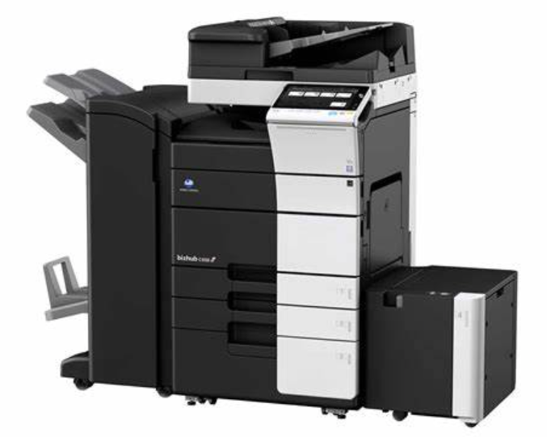
MFD / Printers and Copiers
Multi-function Devices
Project to review status and lifecycle
Currently have about 115 MFD on campus
15 are end of life and replacement parts are no longer available
Lease – 55%
Opportunity for these to get newer and better devices by starting a new lease – normally around the same price point
Trend last few years favors leasing vs purchasing
Purchase – 45%
MFD that were purchased have high up front costs to replace
Moving to leasing model is an option
Best to wait until end of life to get the most out of the device
Next Steps
IS Procurement will reach out with inventory of both end-of-life devices and supported devices
Assist with right-sizing to current models to meet current needs
Assist with any needed upgrades/replacements
Will become an ongoing project to keep these devices updated

Slide 13
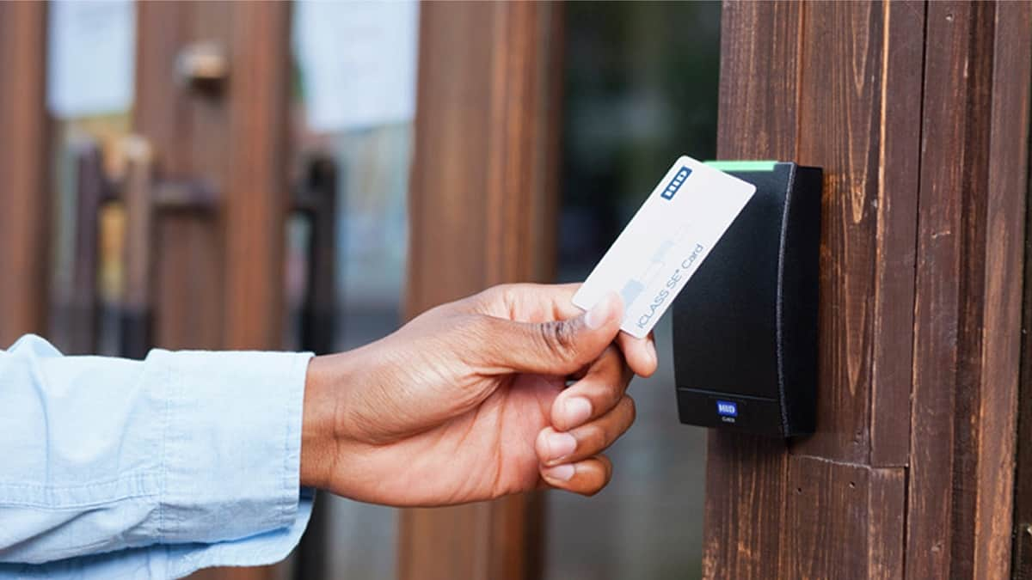
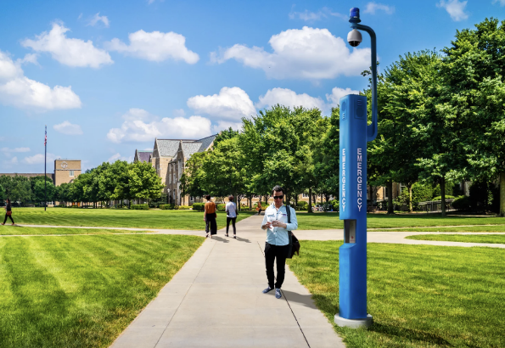
Building / Campus Security Projects
Security Camera Replacement Project - Completed
Divine 9 Monuments - Camera project - Completed
Building Access
Video phones being added to Newcomb and HSB entrances
Working to finalize setup and programming now for Newcomb
Emergency Phone Replacements
(2) campus blue phones targeted for replacement near Flarsheim Hall and Plaster Free Enterprise Center
Hardware on order now for one location
Second location to be updated during campus steam upgrade project on the quad
Campus Security Alarm Upgrades
All alarms updated to a new platform and outside monitoring
Finalizing panic button conversion to CBORD now

Slide 14
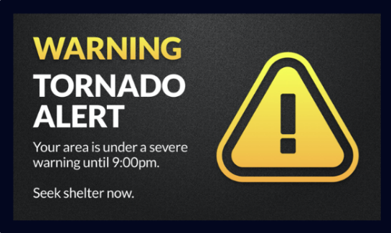
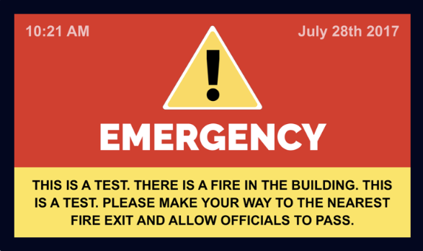
Digital Signage Updates
Rise Enterprise Upgrade - Coming Soon!
Working now to define upgrade timeline now
Many new features included such as: Single sign-on, template sharing, screen sharing, MS Power BI integration, custom, and more.
Rave Integration on Campus Digital Signage is Complete!
When Rave messages are sent, leadership can determine if they also want the message displayed on RISE signage displays.
When this occurs, the signage content is taken over by emergency messaging for a defined period.
This should increase the likelihood that students, faculty, and staff will know there is an emergency.

Slide 15
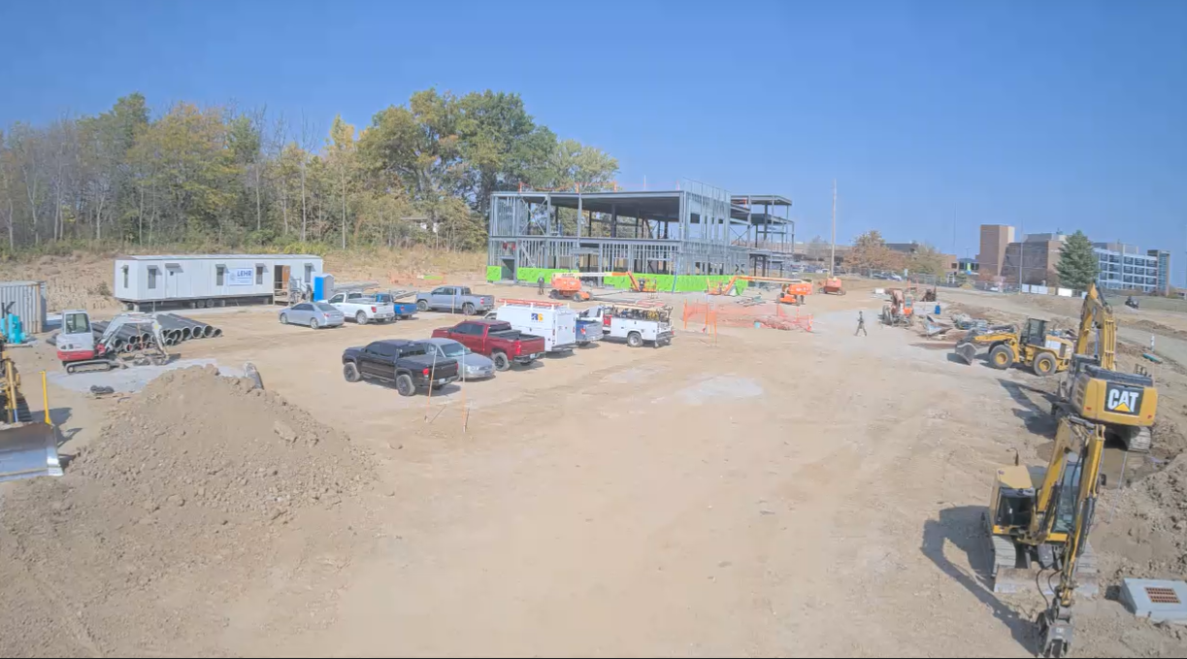
Campus Construction & Renovation Projects
Completed
Student Union AV Upgrades
AC Telepresence upgrades
Student Union Computer Lab Move
Projects Underway
Student Union Food-a-verse – Under Construction
New data cabling pending
MNL 4th Floor Renovation – Under Construction
Ordering equipment now
SOM St. Joseph – Under Construction – Under Construction
Network/Infrastructure hardware ordered
Pending security camera work
Healthcare Innovation & Delivery Building – In Design
Reviewing IT scope now
Partnering with AV Vendor – Network stays in-house
AC Conference Center Renovation – In Design
Demoing/reinstalling AV from all rooms
Installing a new Chancellor’s Dining room
Work begins on Dec 16th
ASSC Building-wide Renovation – In Design
IT scope not clearly defined yet

Slide 16
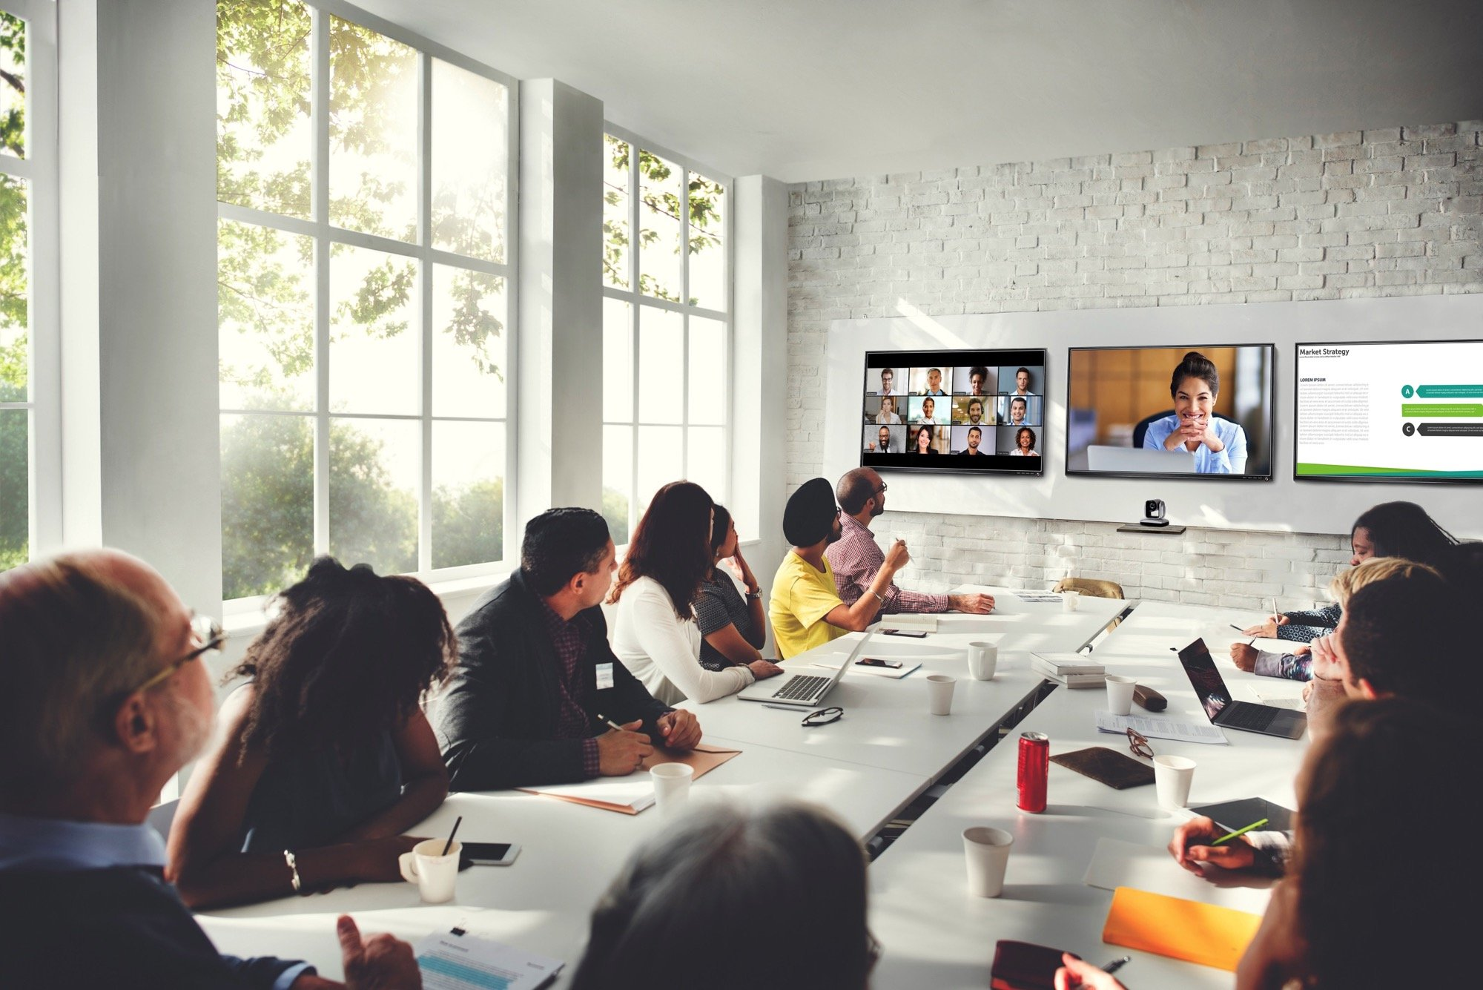
Classroom/Meeting Space Projects – 1
Recently Completed - ~40 Spaces
Admin Center Telepresence, Focus room & Financial Aid – Full AV Upgrades
Atterbury Student Success Center rooms 236, 237, 238, and 102 – Full AV Upgrades
Bloch Executive Hall – Video wall replacement
Cherry Hall rooms 415 & 428 – Full AV Upgrade
Cockefair Hall room 105 – Full AV Upgrade
Education rooms 115, 118, 119, 243, 357 – Full AV Upgrades
Fine Arts room 106 – Full AV Upgrade
Flarsheim Hall 460 – Full AV Upgrade
Grant Hall rooms 140, 221, & Piano Lab – Full AV Upgrades
Health Sciences Building room 4308 – Full AV Upgrade
Law room 2-101 – Full AV Upgrade
Miller Nichols Learning Center room 151 – AV Upgrade pending projector and speakers
Miller Nichols Library room 121 – Full AV Upgrade
National Museum of Toys and Miniatures presentation spaces (2) – Full AV Upgrades
Performing Arts Center room 109 – Full AV Upgrade
PharmD program upgrades at MU – 3 classrooms – AV upgraded, fine-tuning pending
Royal Hall 4th floor classrooms (3) – Full AV Upgrades
Student Union room 401 – Full AV Upgrades

Slide 17
Classroom/Meeting Space Projects – 2
Projects Underway – Pending Completion
Admin Center Conference Rooms (demo/re-install) + Chancellor Dining Room – January 2025
Bloch Executive Hall Classroom Upgrades – defining scope now
Health Sciences Building rooms 3302, 4302, 5302 – Full AV upgrades Fall/Winter 2024
Law School room 007e – in process, to be completed by winter break
Miller Nichols Library 4th floor student success renovation project – spring 2025

Slide 18
Infrastructure & Network Projects
Recently Completed
Arc-GIS Infrastructure Mapping
Outside POP Sites HH and Volker Campus
In-depth detail mapping of HH Campus
Projects underway – pending completion
Dental Network improvements – Near Complete
Installing 10GB service in target areas now
Grant Hall Wi-Fi Upgrades – Starting
Installing new/additional access points now
Arc-GIS Infrastructure Mapping - Ongoing
In-depth detail mapping - Volker Campus
School of Medicine Power Changes – 10/21/24
Moving equipment to keep network active during outages
Hospital Hill Steam Pipe coordination – Ongoing
Protecting copper and fiber cables in the direct path of this project.
MO OneCall – Ongoing

Slide 19
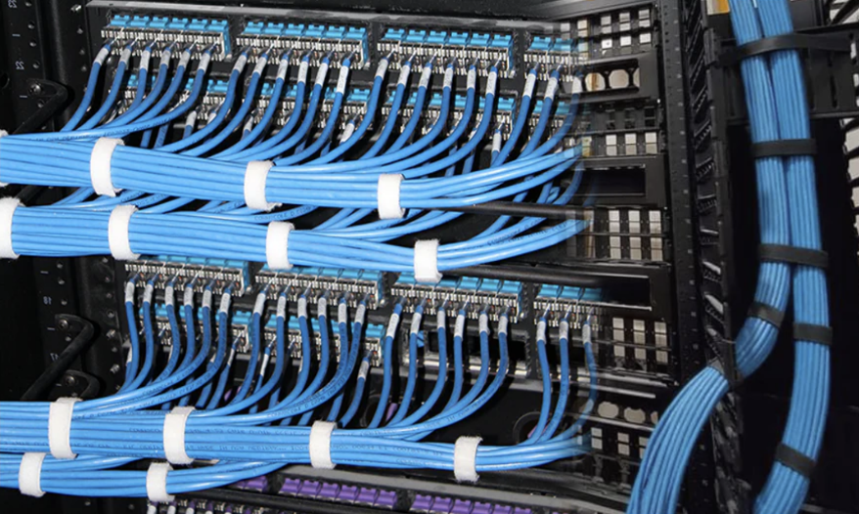
Networking Update – 1
Building Network Lifecycle Upgrades
Multigigabit desktop connections, 60 watts Power-over-Ethernet & 25Gb uplinks
Cherry Street Garage - New switches installed July 2024
Atterbury Student Success Center - New switches installed July 2024
Miller Nichols Library 4th floor and building Distribution – Awaiting Construction
MoreNet Fiber Path Upgrade to Campus
Improve off-campus network resiliency via direct fiber path from Hospital Hill to MOREnet
Fiber path between downtown to Volker campus via Gilliam by Zayo.
100 Gig uplink to MOREnet in Downtown Kansas City – Complete
Fiber path between downtown to School of Medicine via Holmes by Everfast
100 Gig uplink to MOREnet in Rolla, MO - Complete
Campus Phone System – Hybrid Cloud
Renewed phone system & contact center service
Jabber softphone will be migrated to WebEx App client
Phone features: SMS integration, PCI compliance
Contact Center features: Multichannel agents, web client, AI bots

Slide 20
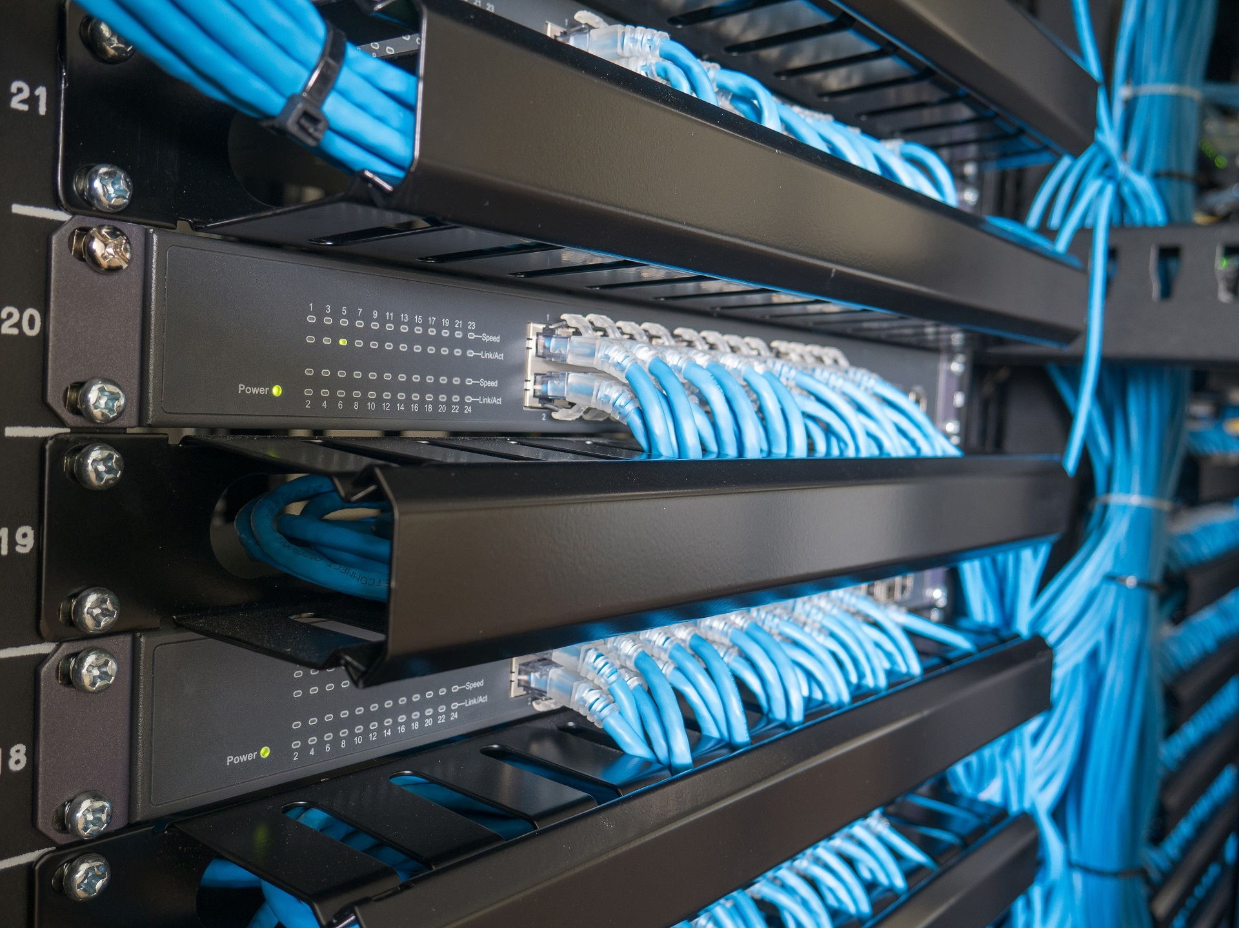
Networking Update – 2
Newcomb Hall Data Center Upgrades
Fire suppression system
Received quote for fire control panel replacement
Reviewing options and phasing
Outdoor Wireless
Improved wireless coverage in outdoor spaces
Adding 3 new APs to Swinney / Atterbury area – Construction underway
Indoor Wireless
Improved wireless coverage in UMKC buildings
Replaced 176 indoor Access Points with the newest WiFi 6E standard
New Building Construction
Working with campus partners and architects to design building network and security systems
Miller Nichols Library 4th floor – Design underway
School of Medicine – St. Joseph – Design underway
Health Innovation & Delivery Building – Design underway

Slide 21
Business Development
Terra Dotta
Terra Dotta is a global engagement platform to facilitate cross-cultural learning experiences for students, faculty, and staff worldwide.
Groups involved include Information Services, International Student Affairs Office (ISAO), Study Abroad and Global Engagement (SAGE), Institutional Research.
The project implements the following Terra Dotta software modules: International Student and Scholar Services (ISSS), Travel Registry, Agreements, Engage, and Dashboards.
This project also updates the existing Study Abroad module data feed, site builder, and SSO log-in features.
This project is projected to close in Fall 2024.
Canusia
Canusia is an industry leader in concurrent and dual enrollment management, and creates an easy-to-use and custom digital toolbox.
The High School College Partnership (HSCP) office spearheaded this project, with the assistance of Admissions, Registrar, International Student Affairs Office (ISAO), Cashiers, Information Services, Institutional Research, and Enrollment Management.
The project scope includes implementing the Canusia software (called myHSCP), using it for admissions and course enrollment, and providing easy access to information for students, families, and teachers.
Phase 1 of project implementation closed on August 1. This phase involved implementing the software for Fall 2024.
Upcoming project phases will include: adding backlogged items for Spring 2025 relaunch and launching supplemental module options.

Slide 22
UM Compliance
National Institute of Standards and Technology (NIST) Assessment - Underway
Homeland Security Cyber assessment for UMKC starting later this month
Reviewing & creating an updated UMKC Threat Matrix for Academic & Business units and key technologies.
New ADA Title II Digital Accessibility Regulations
New DOJ Regulations will require significant changes across the UM to ensure compliance with federal law and access for persons with disabilities.
The final rule establishes a required minimum standard for digital accessibility of websites and web and mobile applications.
Two-year taskforce established on all campuses to work on these changes.
Construction Code & Compliance Changes
New UM requirement contractors or in-house department performing work
IS and CFM required to submit permit requests for work that impacts building structures and existing fire rated areas/assemblies.
UM has a contract with GBA Consulting
Fees for GBA plan review & permitting administration start at $300 and scale based on project scope.
IS Infrastructure and classroom teams completed additional fire stop training
New UM Chief Privacy Officer Hired - Jennifer Thorpe
IS has met with Jennifer and discussed her plans for many changes
No detailed plan or timeline yet.

Slide 23
Administrative Updates
FY25 IS Updates
For the FY26 software budget, IS plans to centralize some software purchases so that we can keep track of the costs better centrally
IS leadership is working to update multi-year staff plans now in preparation for FY26 budget planning
UM CIOs approved new charter documents for the UMS-IT Security and Compliance, Infrastructure and Architecture, Applications and Development teams.
These teams meet regularly to collaborate on UM shared solutions, when possible, contribute knowledge and expertise on system projects and stay on top of what all campuses are doing in key IT support areas.

Slide 24
THANKS!
Any questions?

